Slide 1
Energy Consumption Analysis
- Purtee BHISE, NEELAM Gujar, NEHA SHIRODKAR

Slide 2
Data EXPLORATION:
House Data
Weather Data
Energy Data
Included July data only (highest energy usage month)
Every house contains energy and weather information for each hour of July
Aggregated the data by day for modeling.
Predicted and analyzed the data.

Slide 3
Project Goal
Understand historical energy usage and affecting factors
Provide recommendations on how to reduce overall energy usage
Predict next year’s energy usage based on increased temperatures

Slide 4
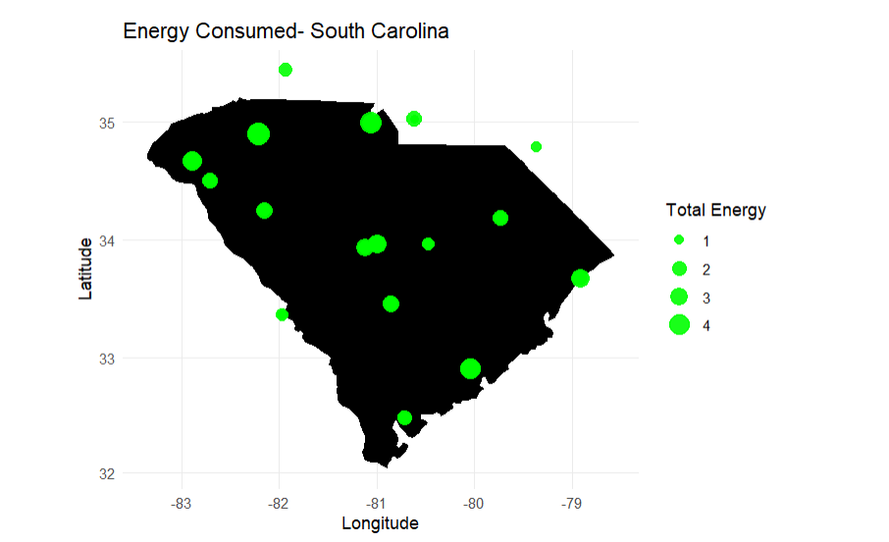



Map of City Energy Usage:
The data is collected from major cities in South Carolina such as Charleston, Myrtle Beach, Hilton Head, etc.
The cities with the highest energy usage include Goose Creek and North Charleston.

Slide 5
variables Having most impact on energy usage:
We determined 40 variables relating to house data that had a significant impact on energy usage that we can use in our model.
Examples:
Roof Material
Wall Type
Type of Insulation
Light Type
No. Of Bedrooms
Solar Panels

Slide 6
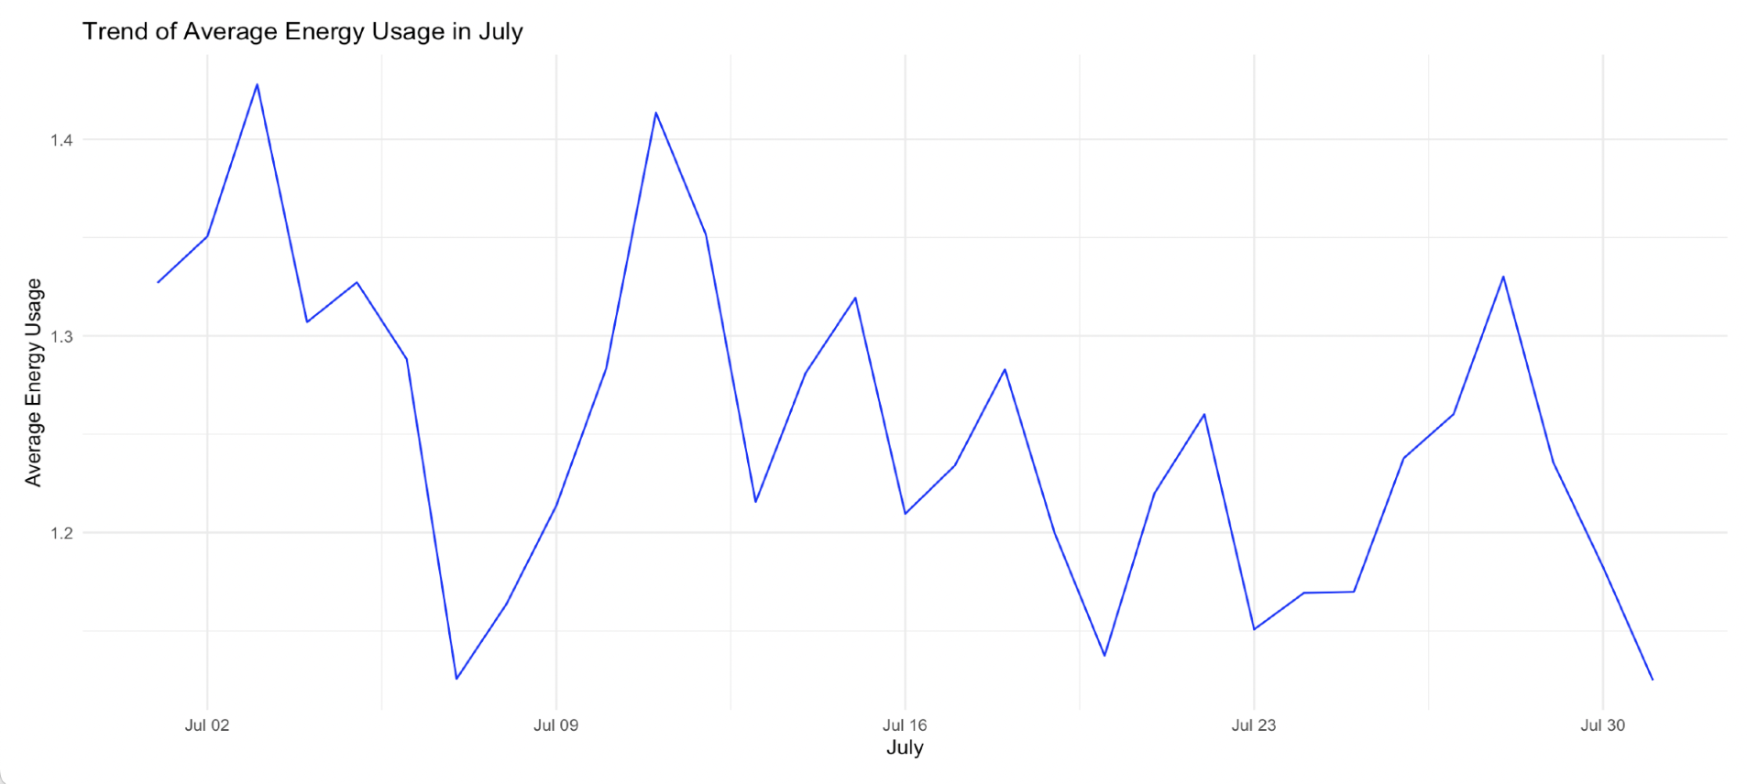
Energy Usage Pattern – Historical Data:

Slide 7
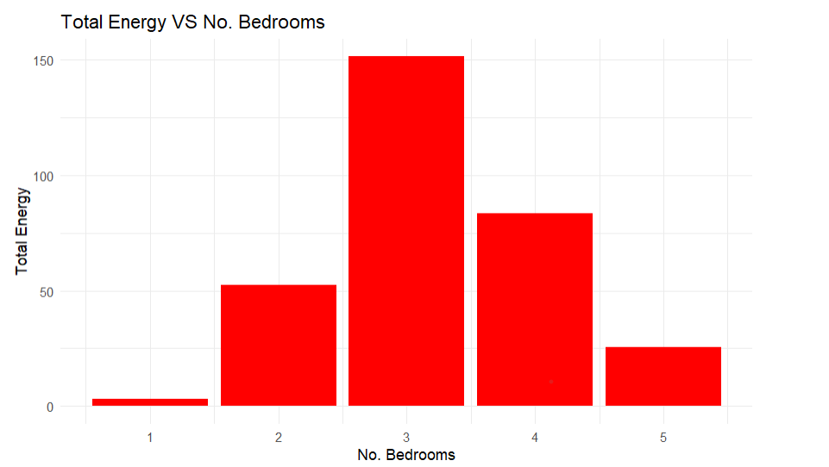
Number of Bedrooms & Energy:

Slide 8
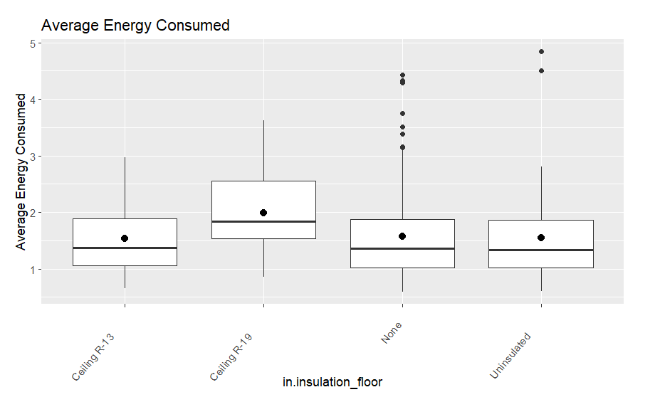
Type of insulation & Energy:

Slide 9
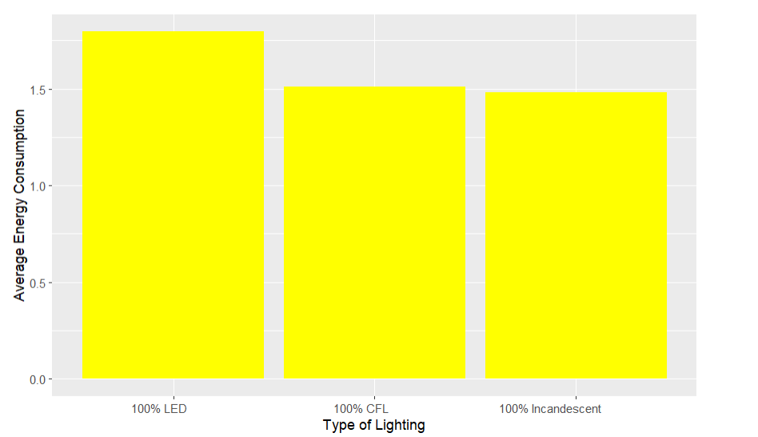
Type of Lightning & Energy:

Slide 10
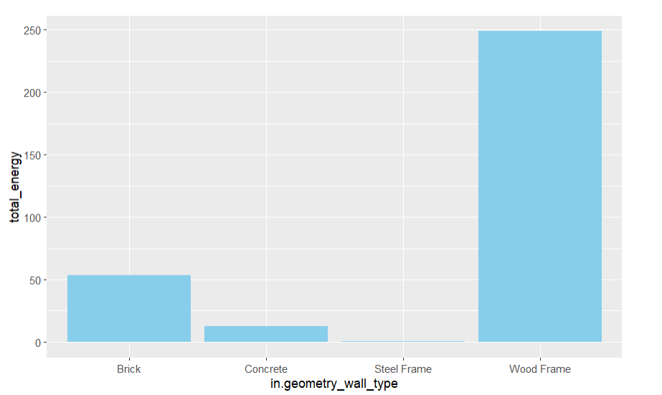
Type of house walls & Energy:

Slide 11
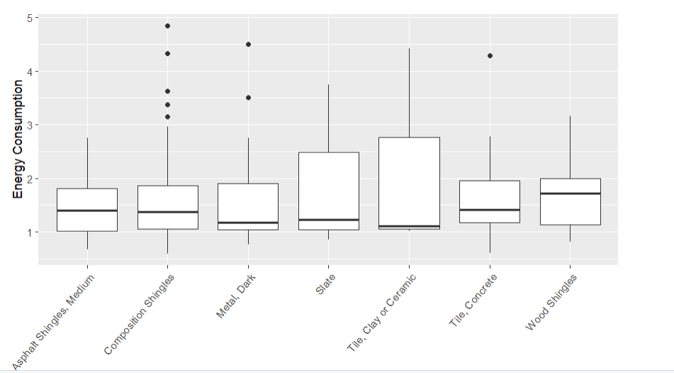
Energy Consumption based on Roof Material:

Slide 12
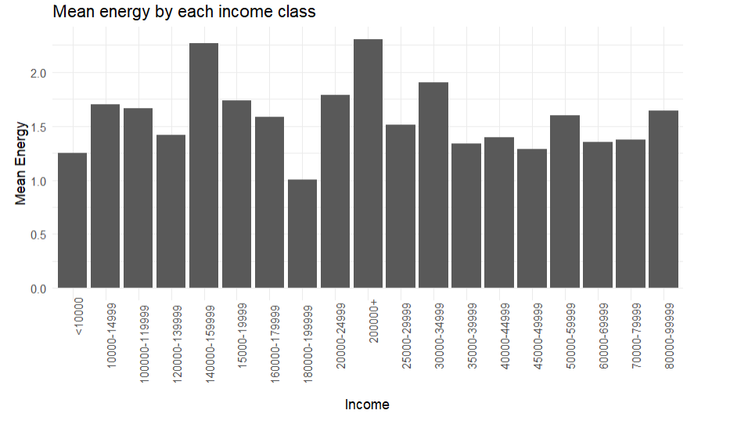
Average Energy Consumption v/s Income:
The household income range is generally directly proportional to the use of energy; however it does depend on other factors as well.

Slide 13

Model Selected: Linear Regression
We can predict 74.75% of the change in energy usage using daily temperature and house information data.

Slide 14
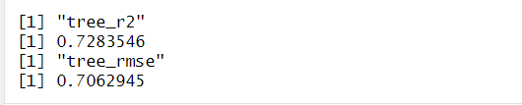
Model : Decision Tree
We can predict 72.83% of the change in energy usage using daily temperature and house information data.

Slide 15
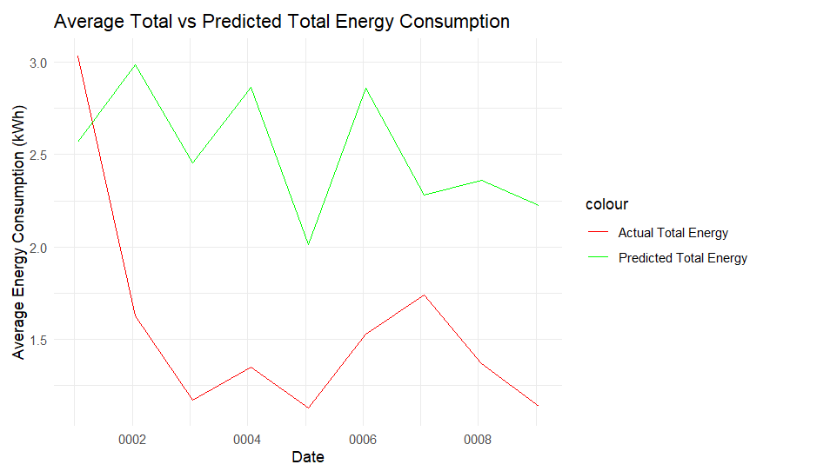
Predicted Total Energy Usage:

Slide 16
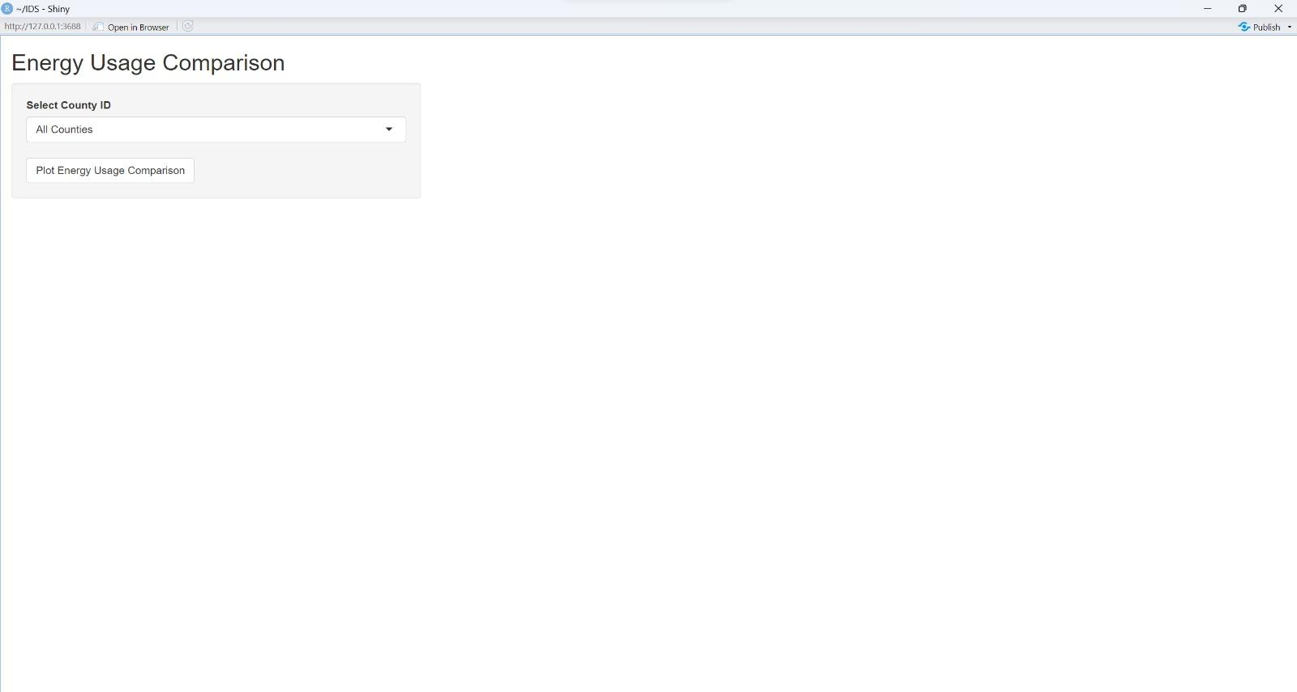
Shiny Application:

Slide 17
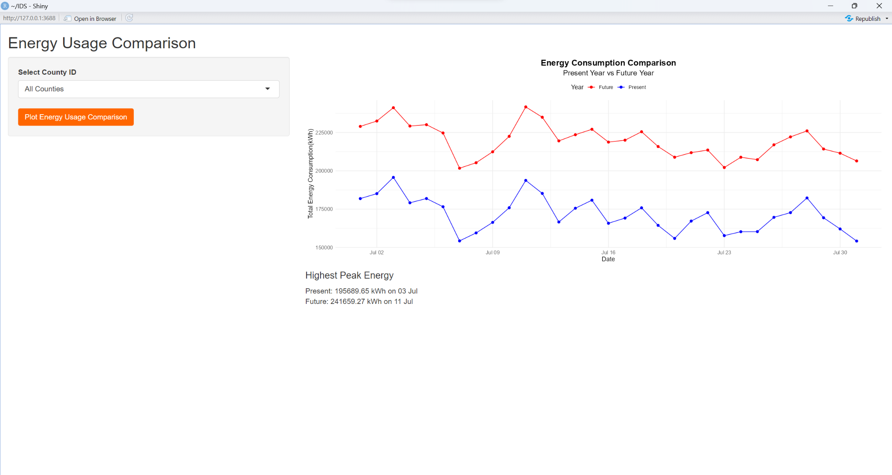
Shiny Application:

Slide 18
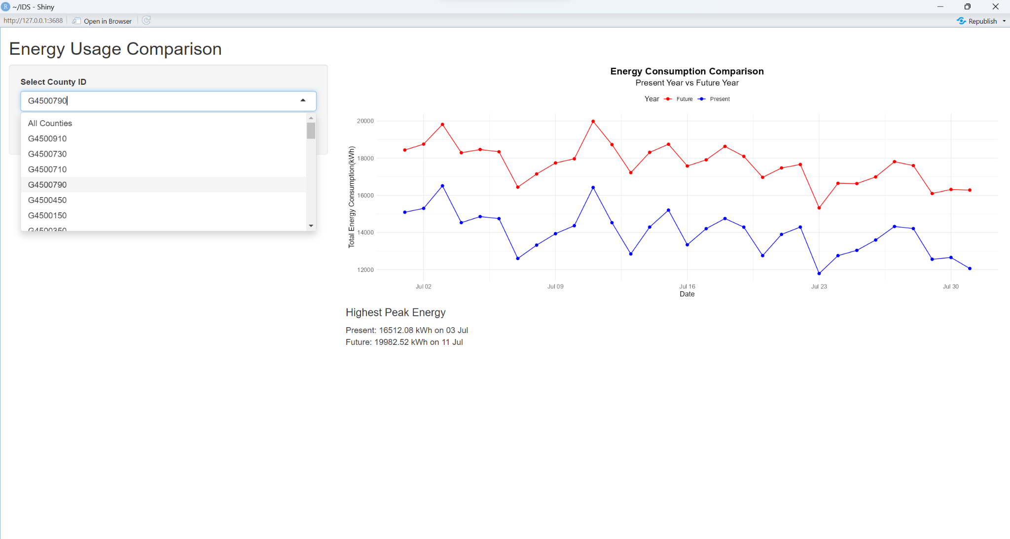
Shiny Application:

Slide 19
Recommendations to Reduce Energy Usage:

Slide 20
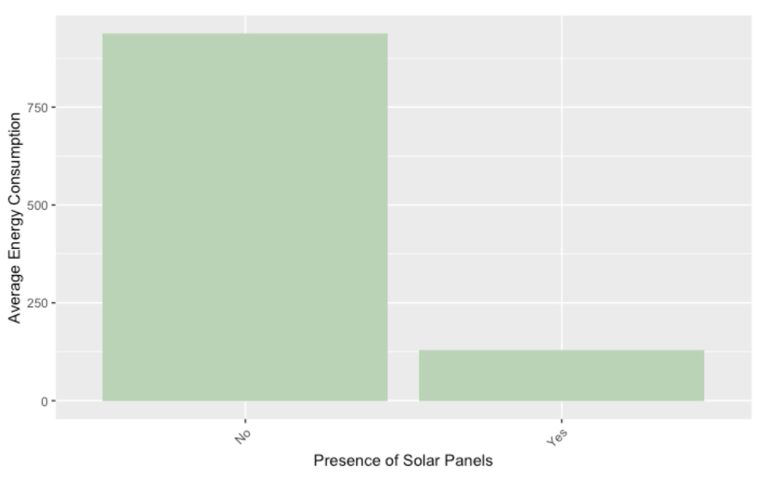
Solar panels reduce energy usage significantly:

Slide 21
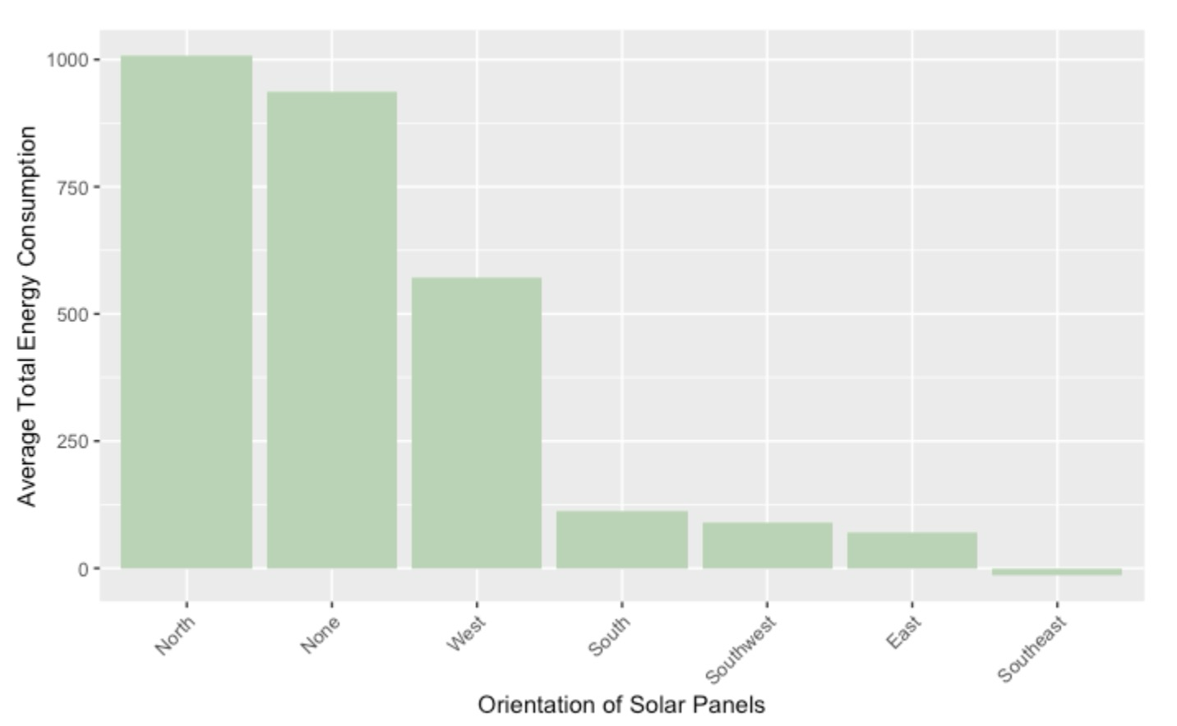
Recommended Orientation of Solar Panels –> Southeast:

Slide 22


